Slide 1


CS 513 B
Knowledge Discovery and Data Mining
Heart Disease Prediction
Group - 5

Slide 2




Group Members
Aman Gupta 20018346
Parth Patel
20010839
Buruju Sowmya 20016102
Ashwin Dhanasamy
20018534

Slide 3
Contents
Dataset Description
Problem Statement
Objective
EDA - Exploratory Data Analysis
Classification algorithms used
KNN Methodology
Adaboost
Gaussian Naive Bayes
Artificial Neural Network
Decision Trees (CART)
Logistic Regression
Random Forest
SVM Methodology
Conclusion

Slide 4
Dataset description
Heart Disease Prediction dataset https://www.kaggle.com/datasets/alexteboul/heart-disease-health-indicators-dataset
Raw Data-
Numerical Columns-
Target Column -
HighBP
HighChol
CholCheck
BMI
Smoker
Stroke
Diabetes
PhysActivity
Fruits
Veggies
HvyAlcoholConsump
AnyHealthcare
NoDocbcCost
GenHlth
MentHlth
PhysHlth
DiffWalk
Sex
Age
Education
Income
HeartDiseaseOrAttack
Number of columns - 22
Number of rows - 253680
Numerical columns- 21
Target Feature - ‘HeartDiseaseOrAttack’
Data after EDA -
Number of columns - 22
Number of rows - 253680
Numerical columns - 14
Data distribution of test and training -
30% for test
70% for training

Slide 5
Problem Statement -
The Behavioral Risk Factor Surveillance System (BRFSS) collects a massive amount of health-related data through a telephone survey conducted annually by the CDC. In this project, we will explore the BRFSS 2015 dataset available on Kaggle, which contains responses from 253,680 individuals, primarily for binary classification of heart disease. However, this dataset suffers from a class imbalance issue, where the majority of respondents do not have or have not had heart disease. Therefore, our goal is to create a classification model that can accurately predict the presence of heart disease.

Slide 6
Objective -
To preprocess the dataset and perform exploratory data analysis to understand the characteristics of the data, identify missing values, and outliers.
To create a classification model to predict the presence of heart disease and evaluate its performance using appropriate evaluation metrics such as accuracy, precision, recall, and F1-score.
To compare the performance of different classification models such as logistic regression, decision tree, random forest, and support vector machines and choose the best model based on evaluation metrics.
To interpret the results of the best model and identify the most important features contributing to heart disease.
6

Slide 7
Exploratory Data Analysis
The dataset contains 253680 rows and 22 columns
The dataset contains two types of columns - categorical columns and distribution columns.
Target Variable: HeartDiseaseOrAttack
Categorical columns:
HighBP, HighChol, Smoker, Stroke, Diabetes, PhysActivity, Fruits, Veggies, HvyAlcoholConsumption, AnyHealthcare, NoDocbcCost, GenHlth, DiffWalk, Sex, Education, Income
Numerical columns:
Age, MentHlth, PhysHlth, and BMI.
c.

Slide 8
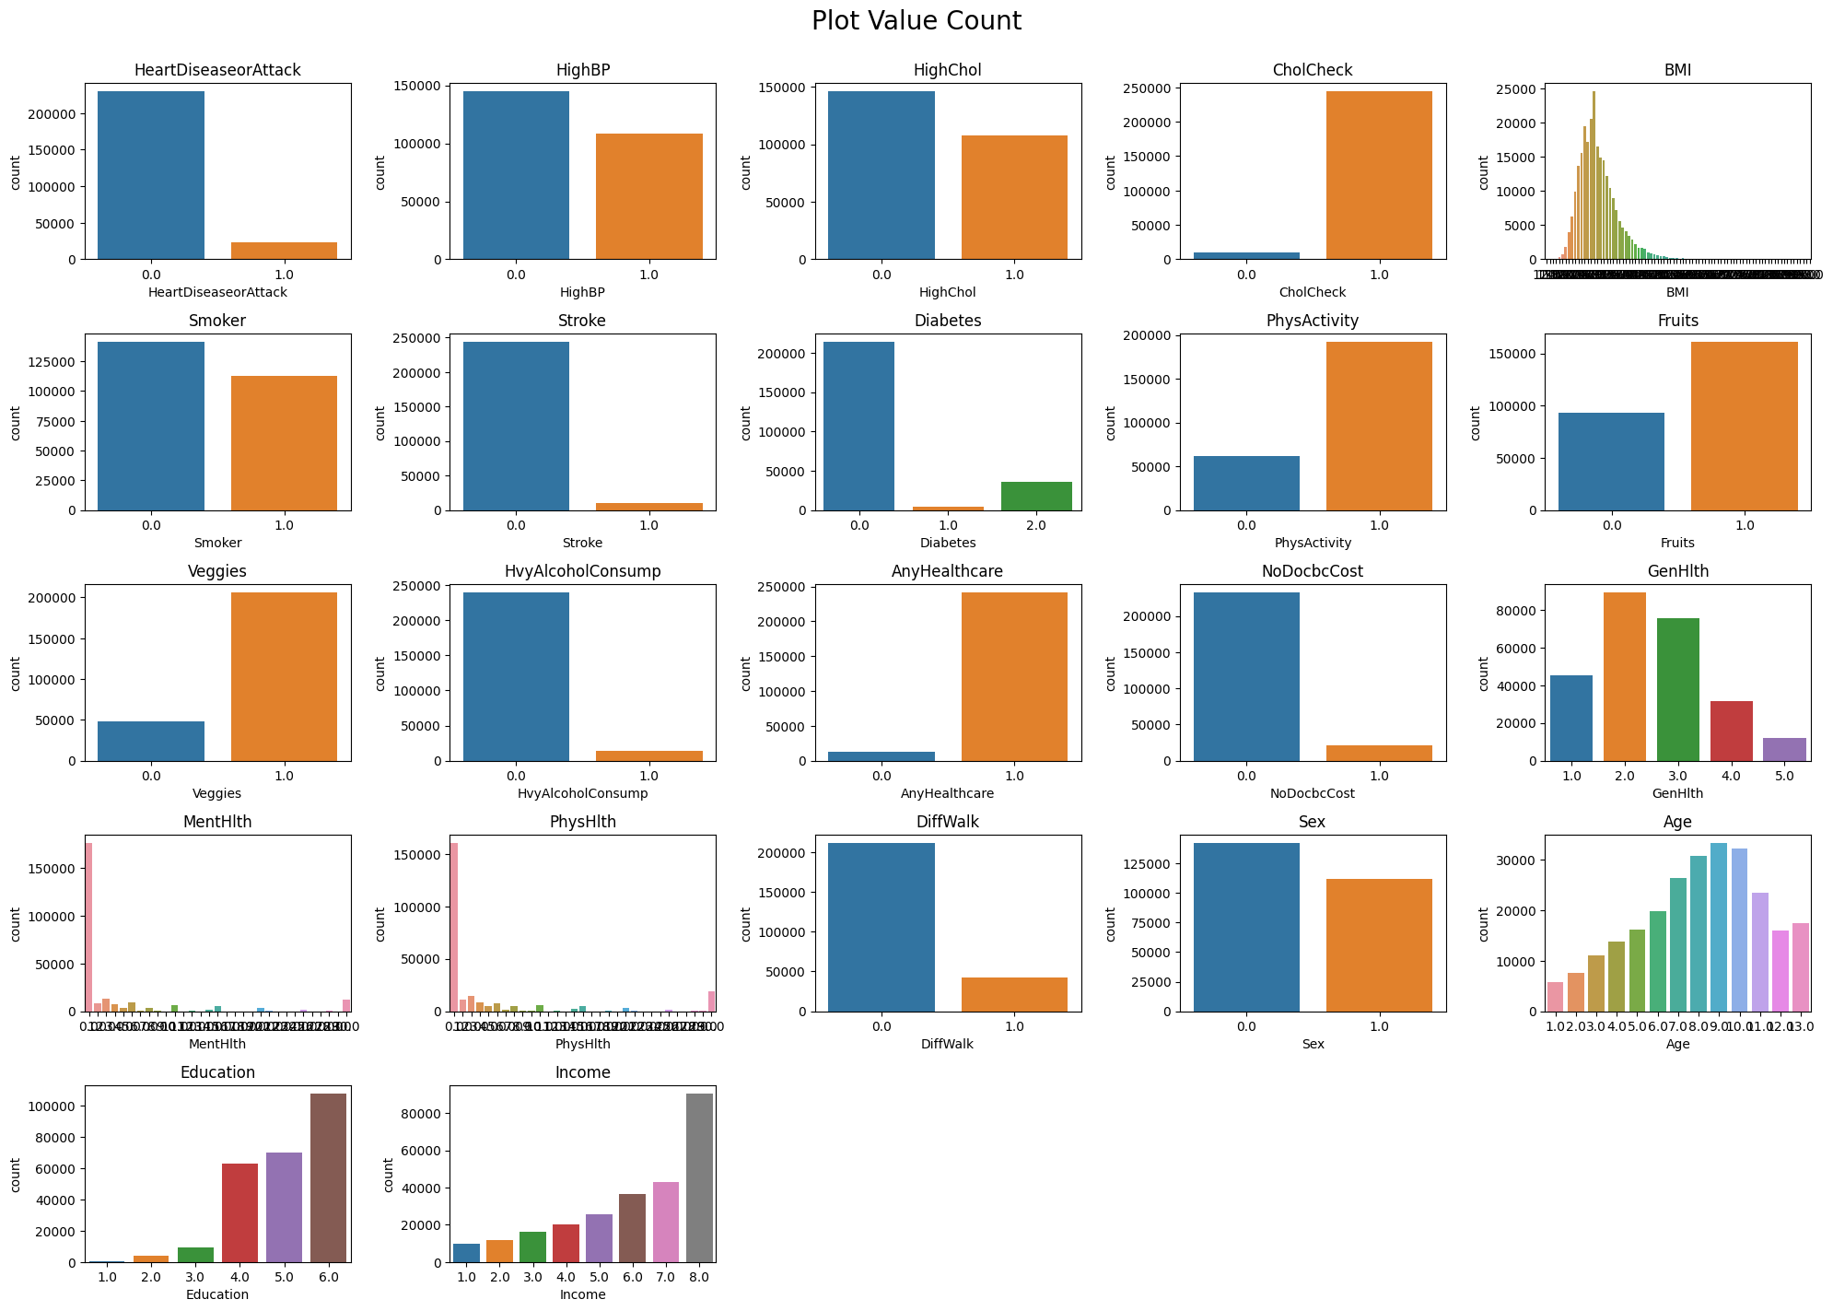
Count Plot

Slide 9
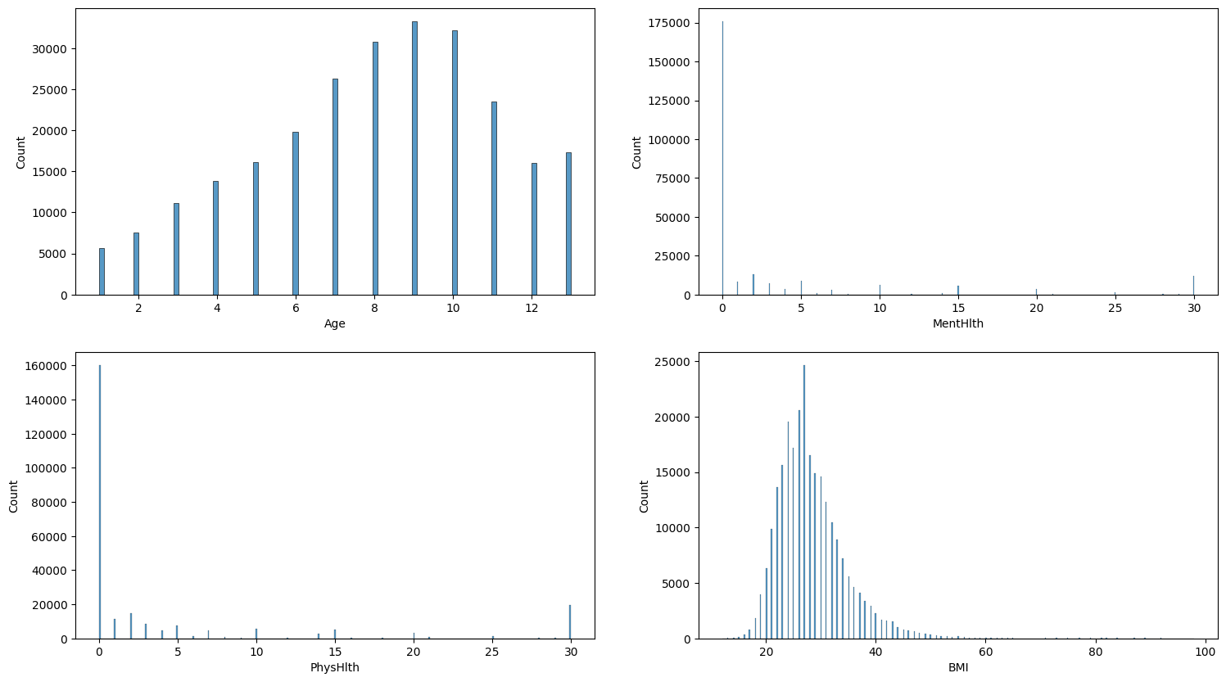
Histogram Plots for continuous-valued columns

Slide 10
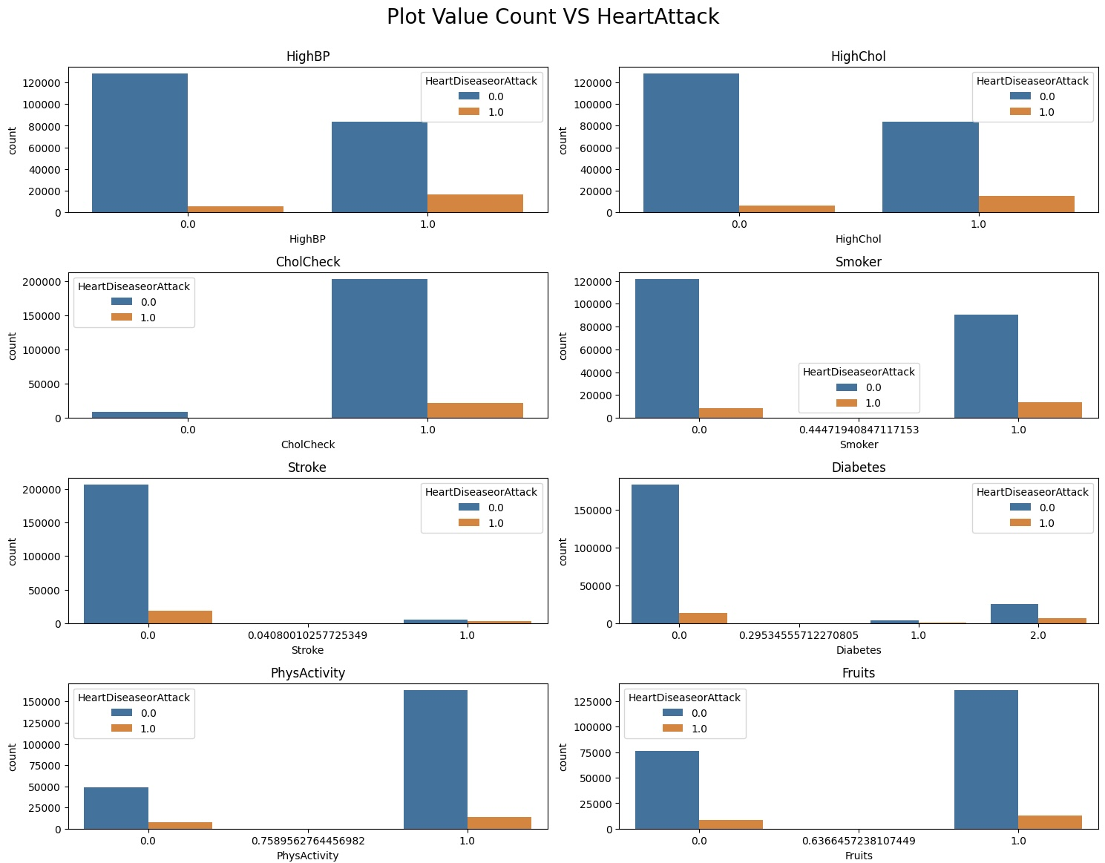
Value Count v/s Heart Attack(1 / 2)

Slide 11
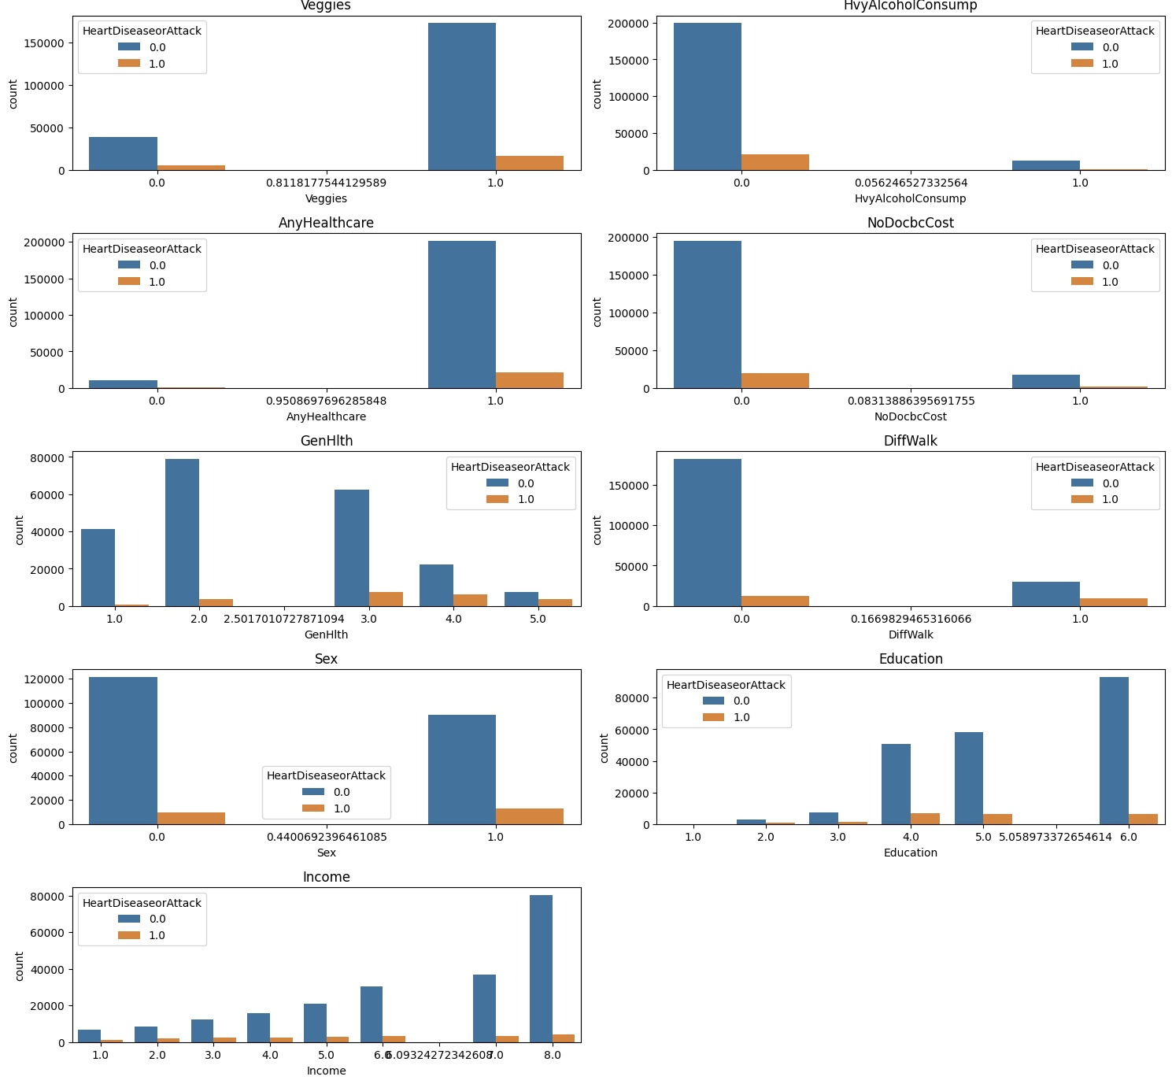
Value Count v/s Heart Attack( 2 / 2)

Slide 12
Exploratory Data Analysis
INFERENCES:
Risk of getting a heart-attack (as expected) increases with factors: High BP, High Chol, Smoker, Stroke, DiffWalking etc.
Risk of getting a heart-attack (as expected) decreases with factors: Fruits, Veggies, Exercise etc.
If you're a female, higher risk of getting a heart attack
No clear pattern/relation between risk of getting a heart attack and Income and Education
No relation between GenHealth and Heart Attack Risk
However, the risk decreases for a person with Heavy Alcohol Consumption. (Imbalanced data representation)

Slide 13
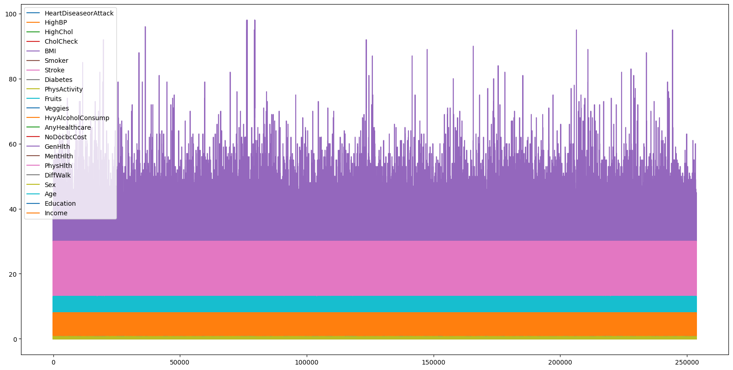
Exploratory Data Analysis
Feature Engineering – Normalization(1/2)
BMI, Age, PhysHlth and MentHlth had very high variance. Normalising these values made the dataset uniformly distributed

Slide 14
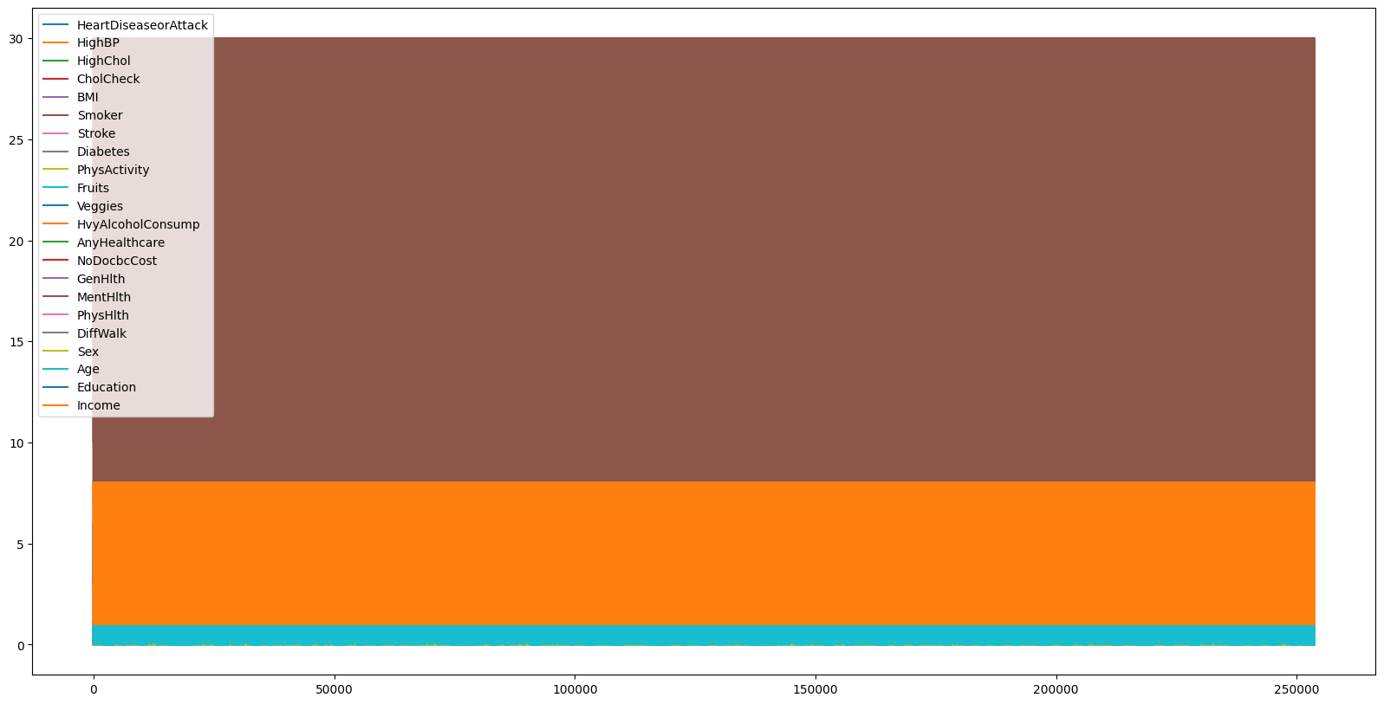
Exploratory Data Analysis
Feature Engineering – Normalization(2/2)

Slide 15
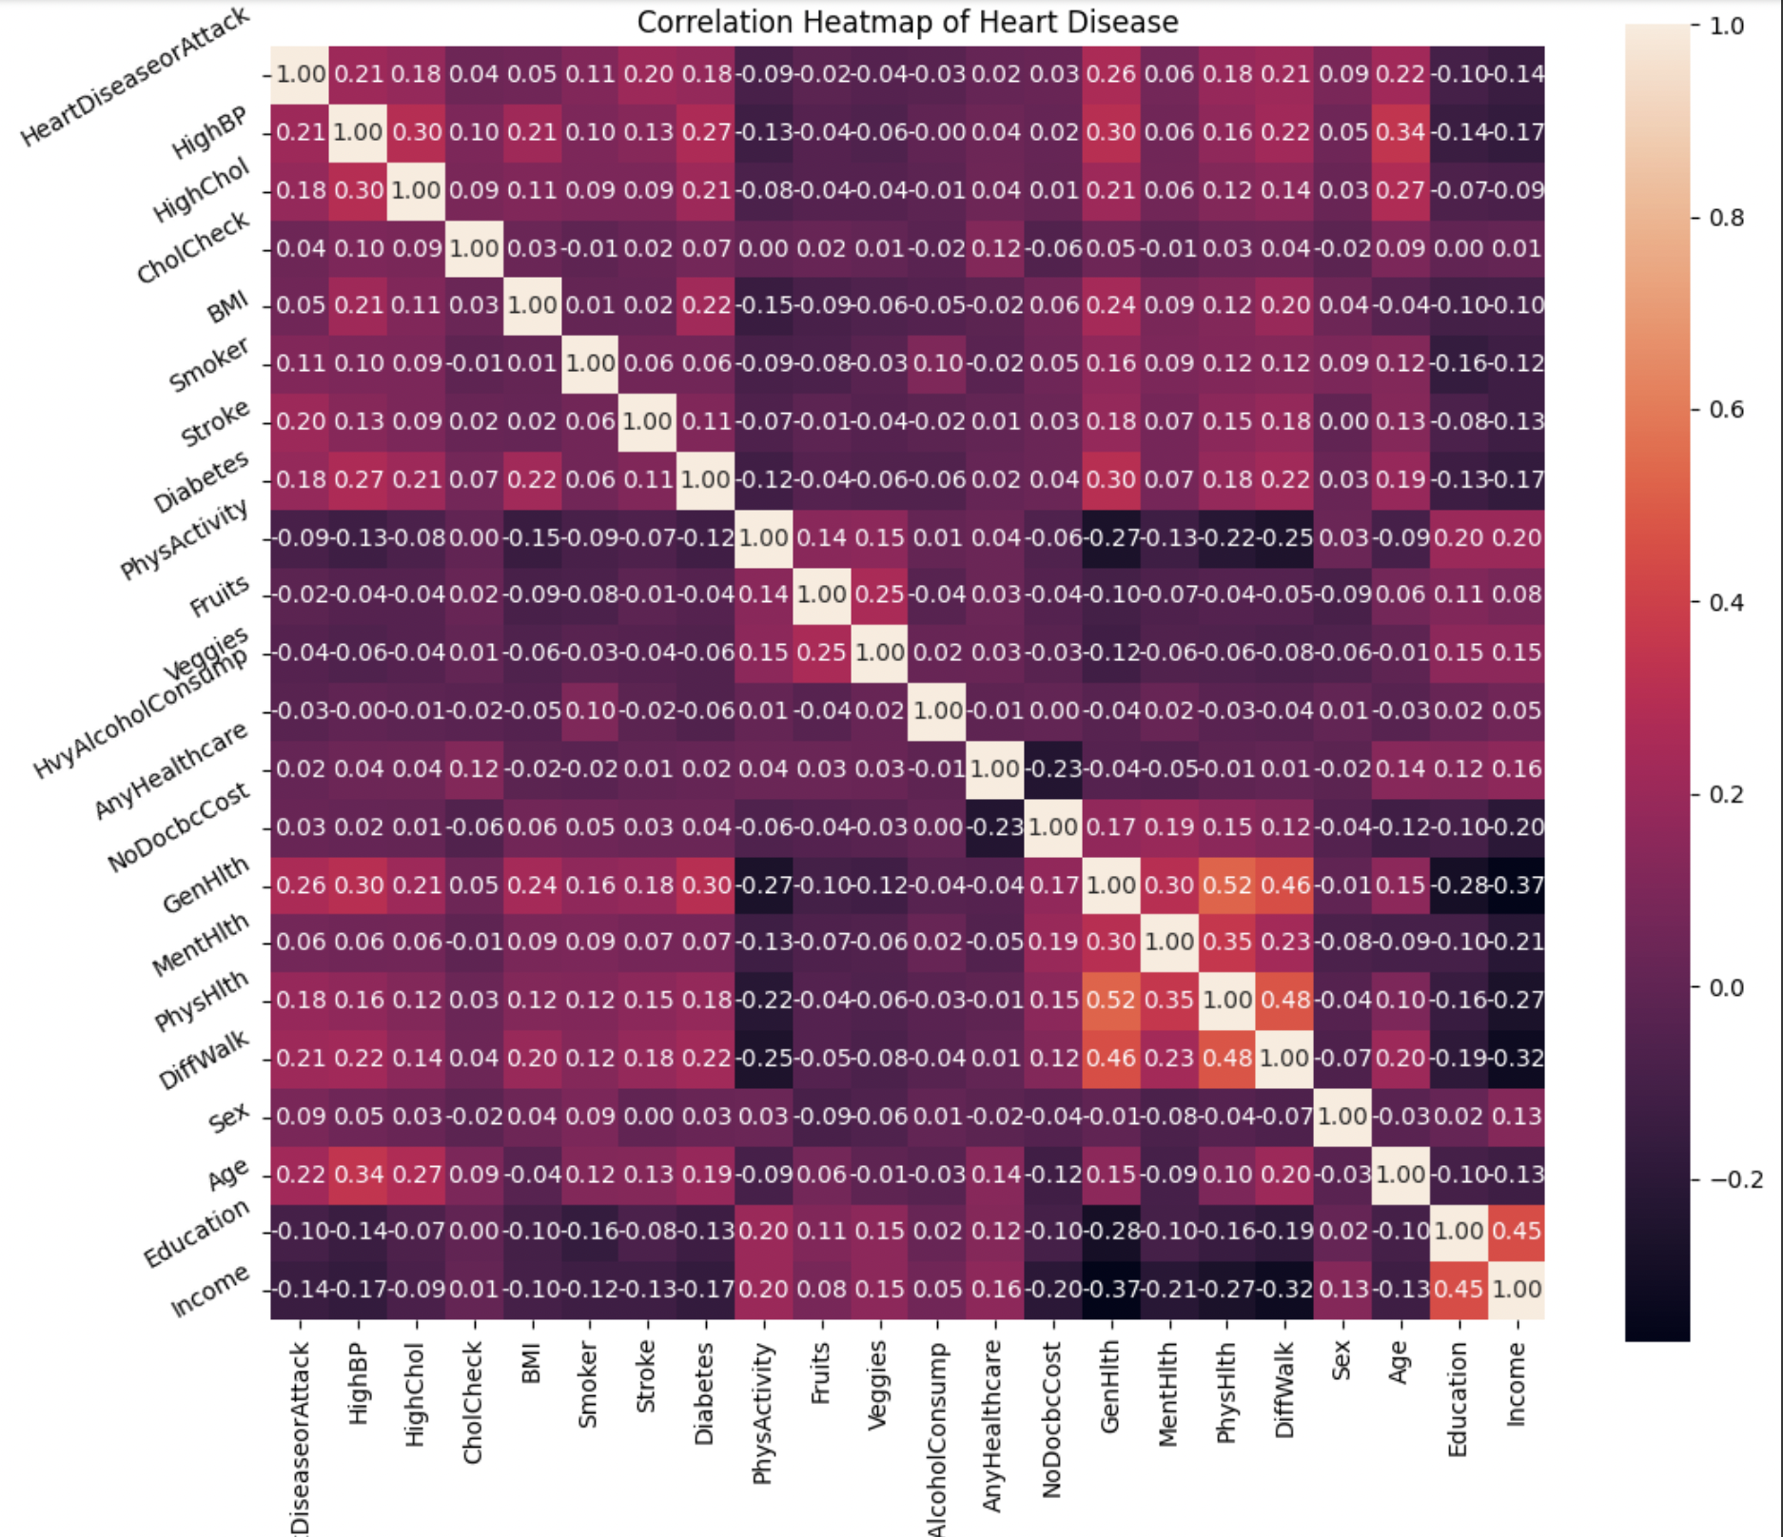
Exploratory Data Analysis
Feature Engineering - Correlation HeatMap

Slide 16
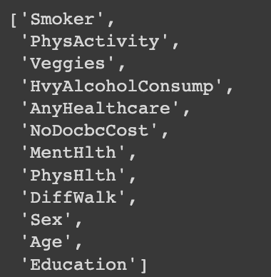
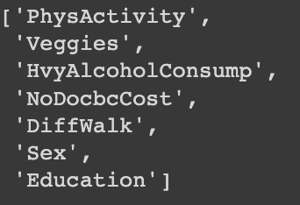
Exploratory Data Analysis
Dropping highly correlated columns helps us by reducing the dimensionality of the dataset and reduces the risk of over-fitting.
We have dropped columns based on 2 different conditions:
Correlation > 0.7 (OR) Correlation < 0.008
Correlation > 0.7 (OR) Correlation < 0.01

Slide 17
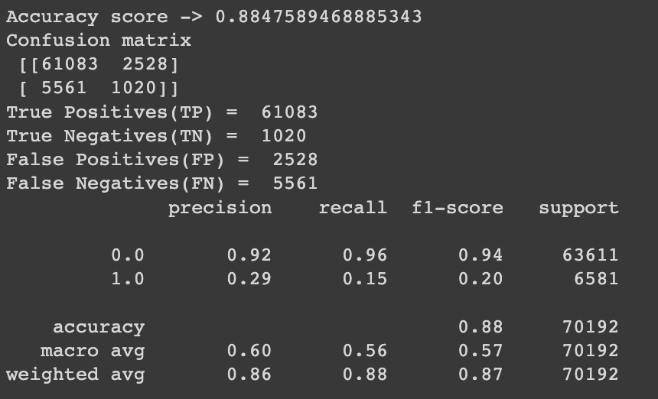
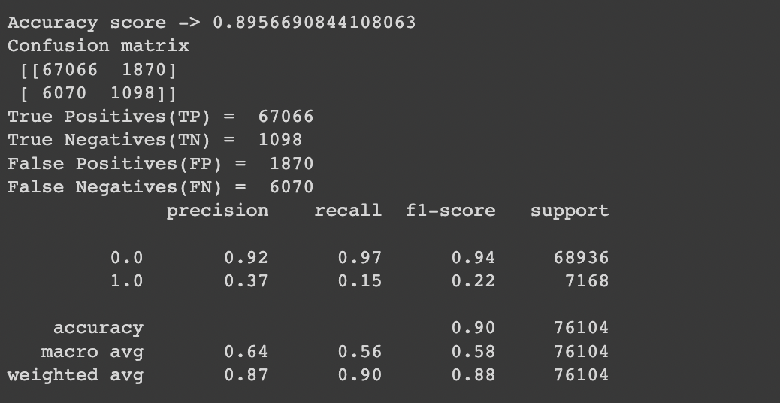
KNN Methodology
Best Accuracy (K = 5) ~ 89.56.5% (after dropping)
No columns dropped Accuracy = 88.4%
Dropping columns based on condition 1 Accuracy =89.56%

Slide 18
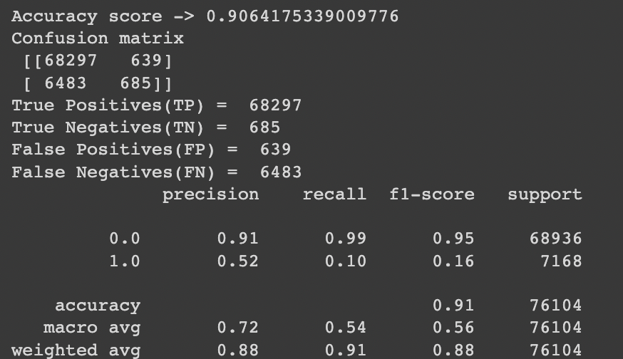
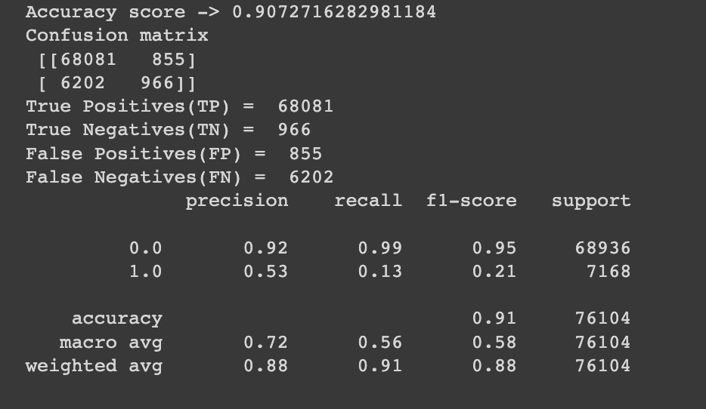
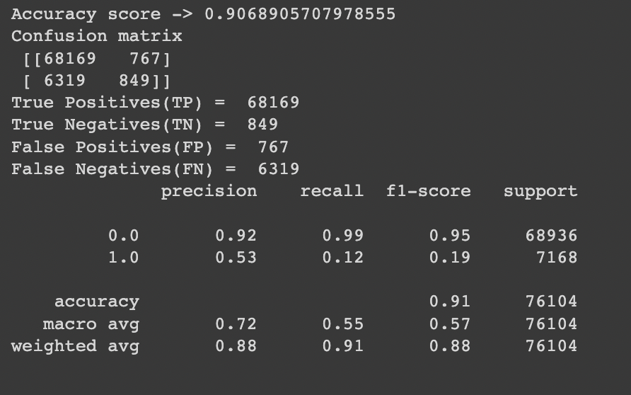
Adaboost
Best Accuracy ~ 90.72% (before dropping)
Dropping columns based on condition 1 Accuracy = 90.64%
No columns dropped Accuracy = 90.72%
Dropping columns based on condition 2 Accuracy =90.68%

Slide 19
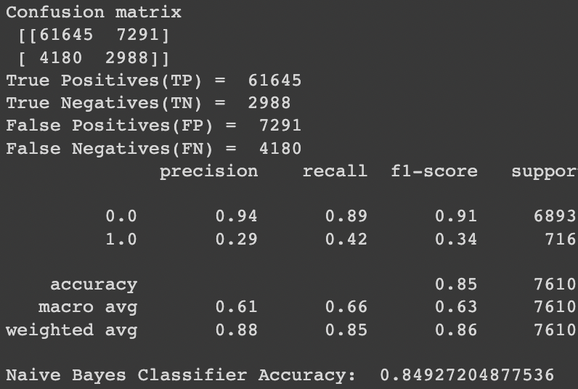
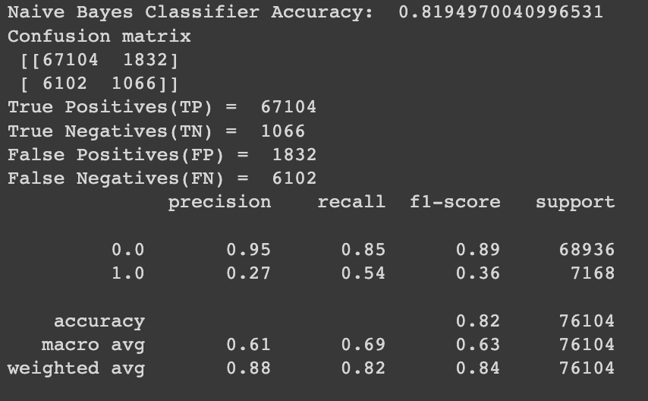
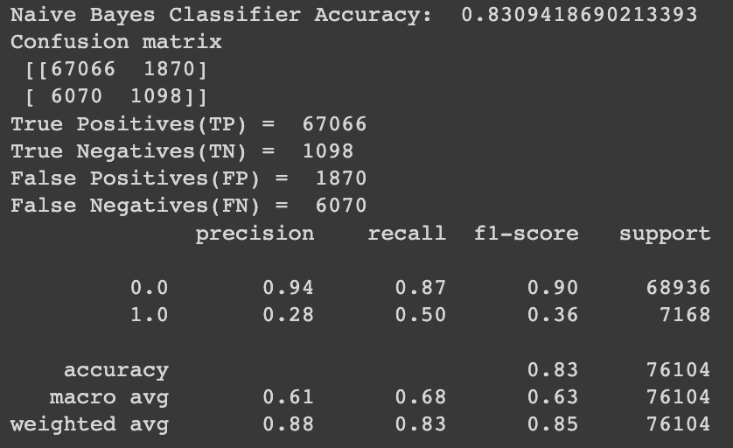
Gaussian Naive Bayes
Best Accuracy ~ 84.92% (After removing more variables)
Dropping columns based on condition 1 Accuracy = 84.92%
No columns dropped Accuracy = 81.95%
Dropping columns based on condition 2 Accuracy =83.09%

Slide 20
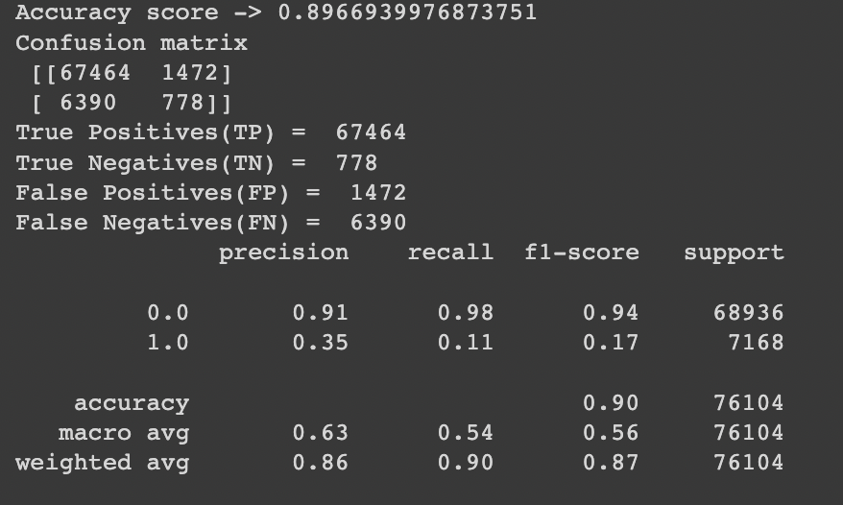
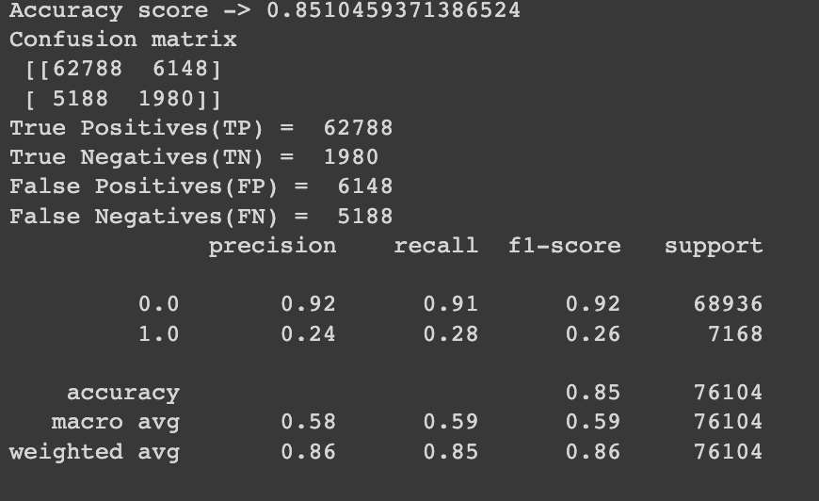
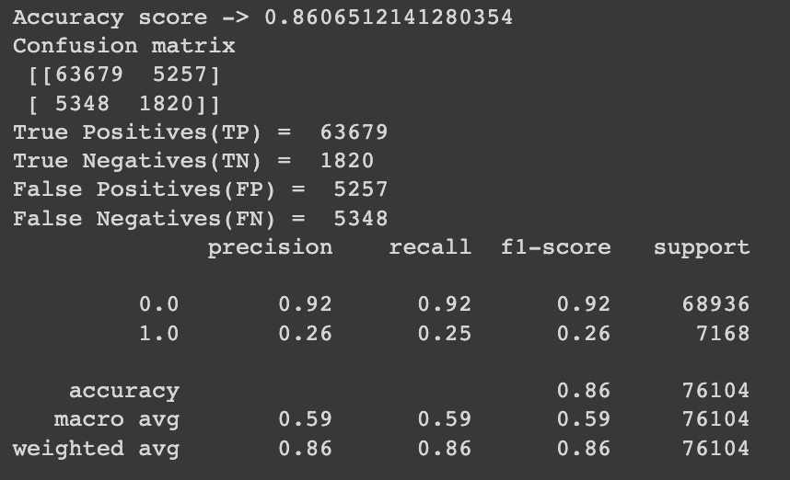
Decision Trees (CART)
Best Accuracy ~ 89.67% (after dropping more features)
Dropping columns based on condition 1 accuracy = 89.66%
No columns dropped accuracy = 85.10%
Dropping columns based on condition 2 Accuracy =86.06%

Slide 21
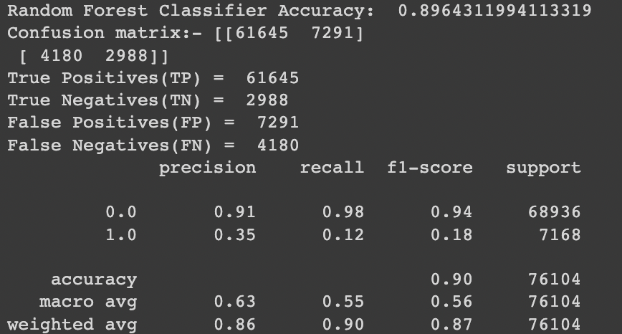
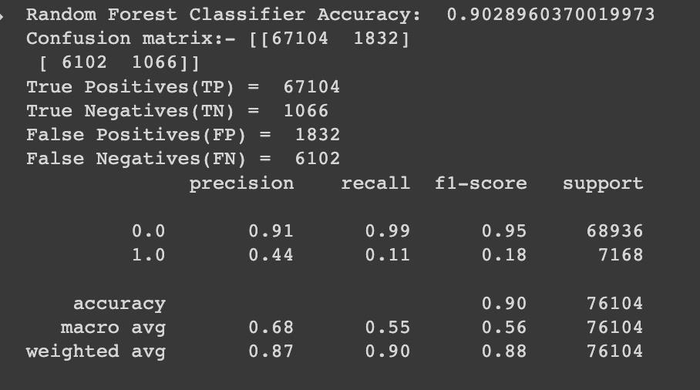
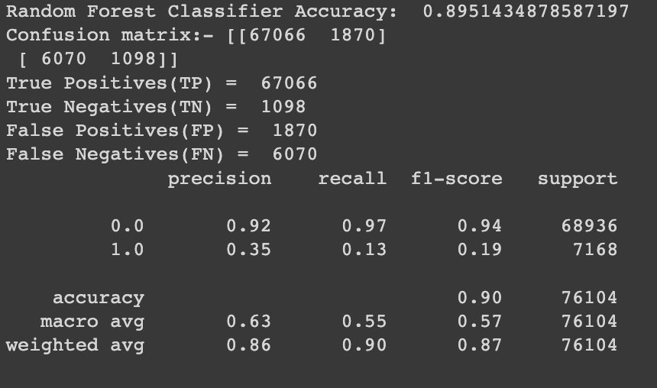
Random Forest
Best Accuracy ~ 90.28% (before dropping the correlated variable
Dropping columns based on condition 1 Accuracy = 89.66%
No columns dropped Accuracy = 90.28%
Dropping columns based on condition 2 Accuracy =89.51%

Slide 22
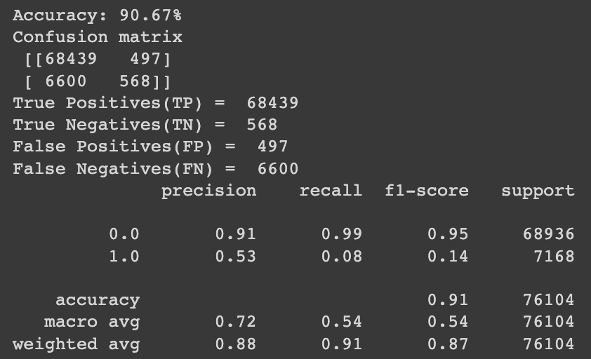
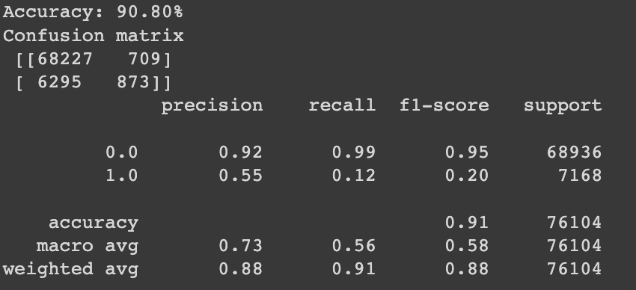
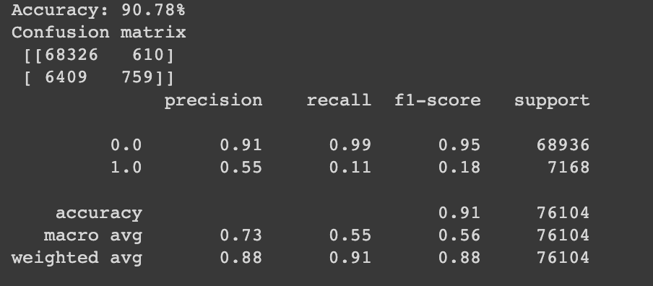
Logistic Regression
Best Accuracy ~ 90.80% (before dropping)
Dropping columns based on condition 1 Accuracy = 90.67%
No columns dropped Accuracy = 90.80%
Dropping columns based on condition 2 Accuracy =90.78%

Slide 23
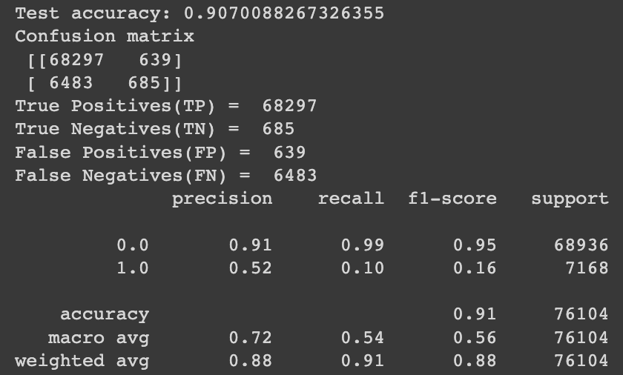
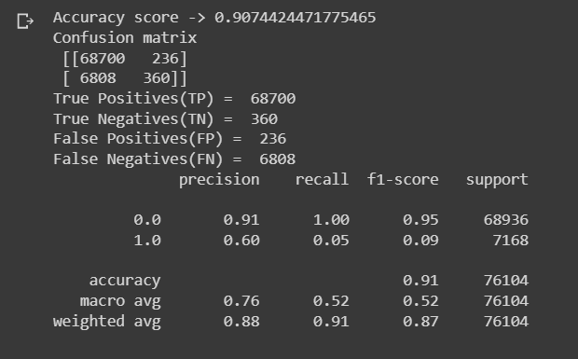
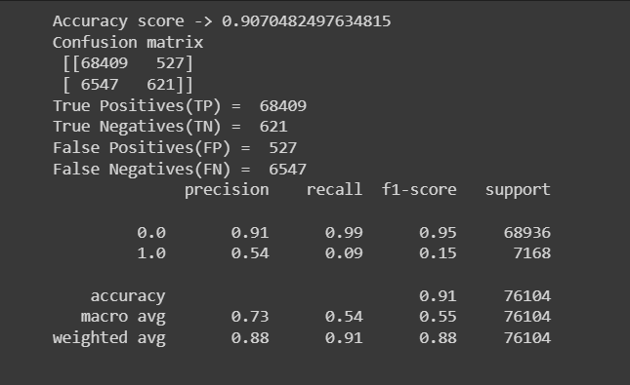
Artificial Neural Network (ANN)
Accuracy ~ 90.74%
No columns dropped Accuracy = 90.74%
Dropping columns based on condition 1 Accuracy = 90.70%
Dropping columns based on condition 2 Accuracy = 90.70%

Slide 24
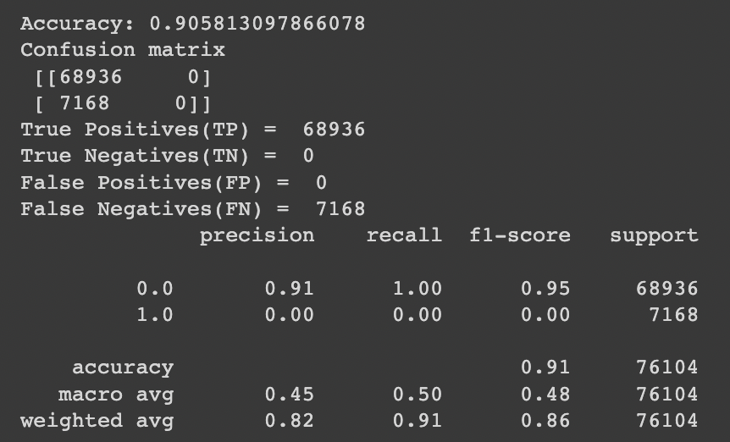
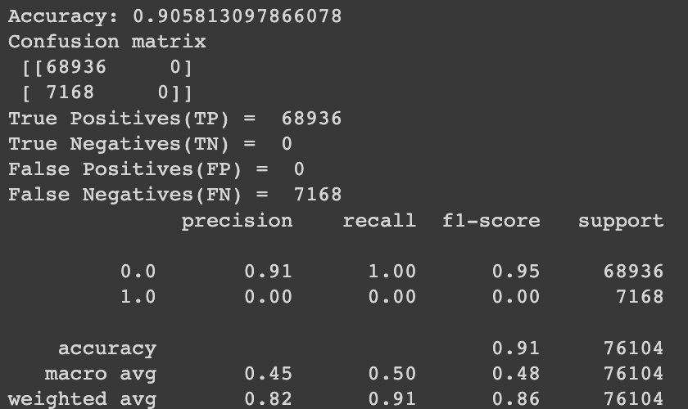
SVM Methodology
Accuracy ~ 90.58% same for after and before dropping
Dropping columns based on condition 1 Accuracy = 90.58%
No columns dropped accuracy = 90.80%
Dropping columns based on condition 2 Accuracy =90.78%

Slide 25
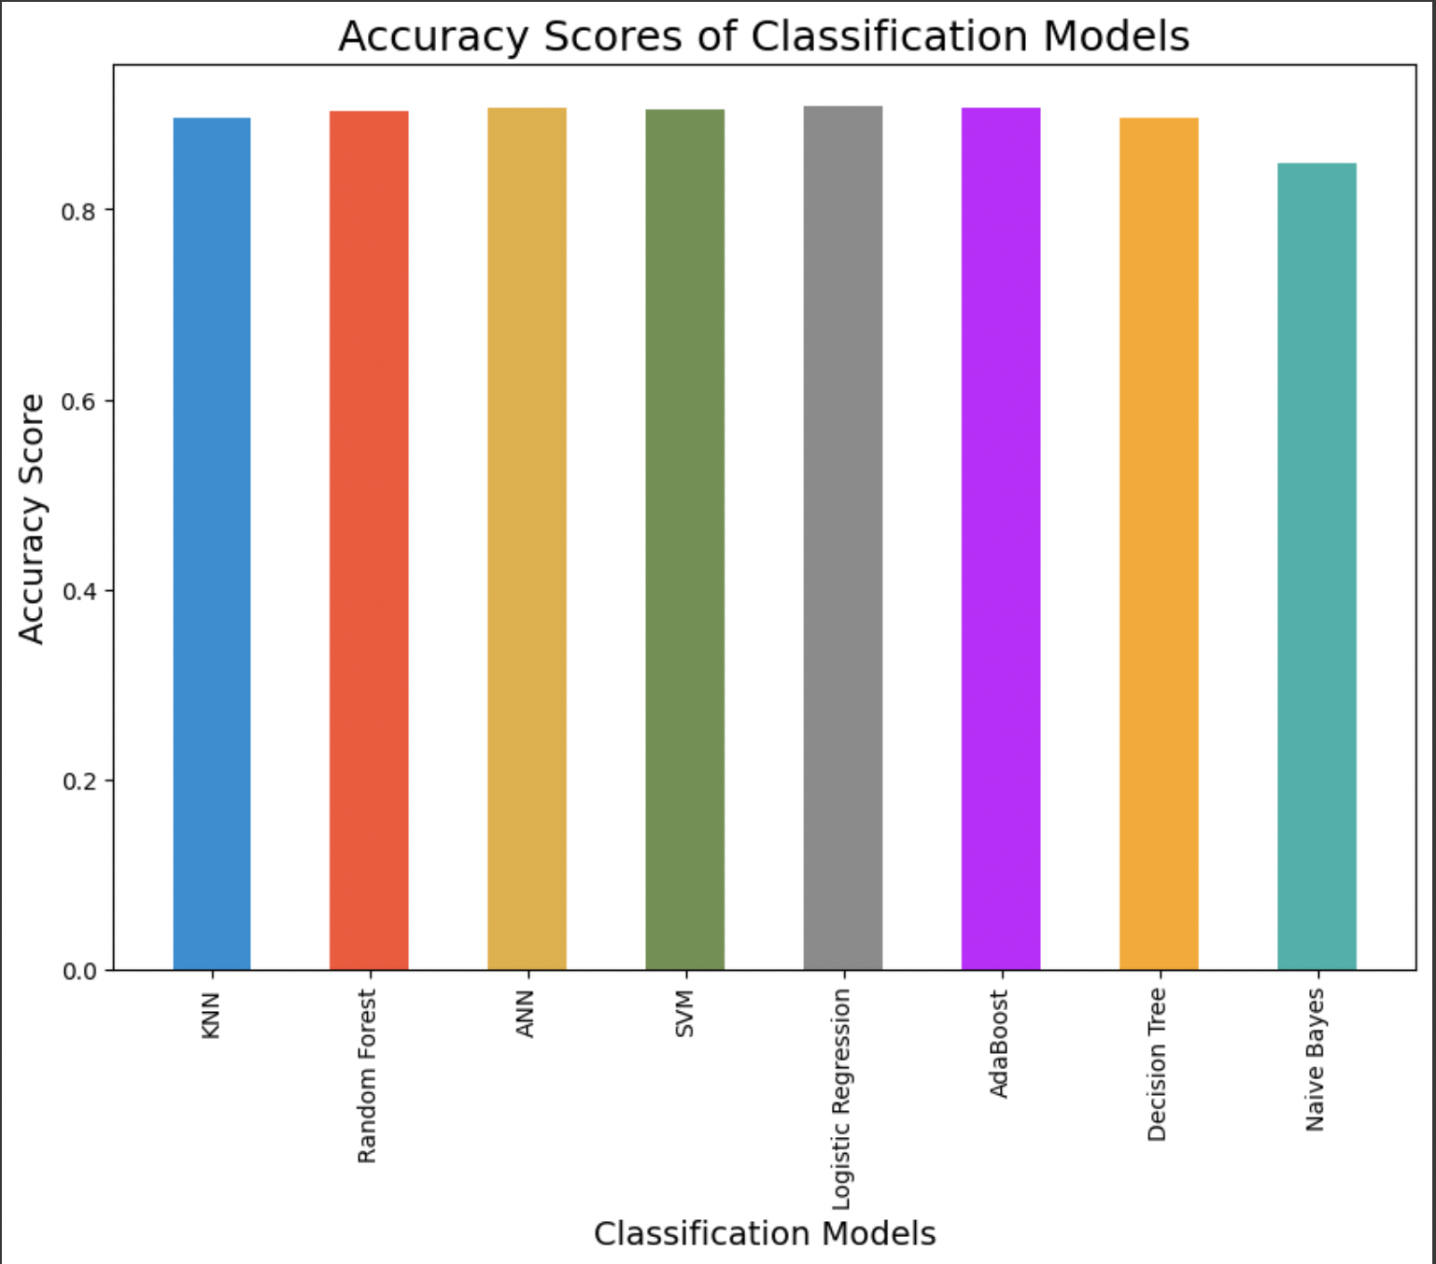
Conclusion and Insights

Slide 26
Conclusion
In conclusion, heart disease is a major public health concern that affects millions of people worldwide. Accurately predicting the risk of heart disease is crucial in identifying individuals who may benefit from preventative measures or early intervention
Based on a wide range of patient data, including medical history, lifestyle factors, and demographic information, our best model achieved an accuracy of 90.8 percent.

Slide 27
THE END

